Slide 1
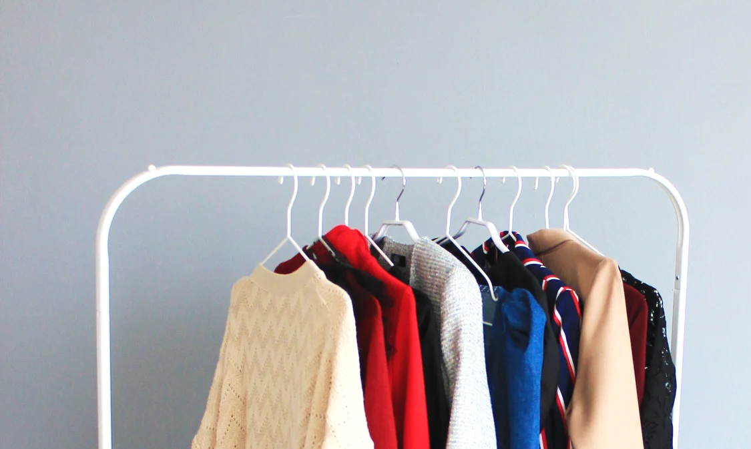


EL- SAMAD
For Men & Women

Slide 2

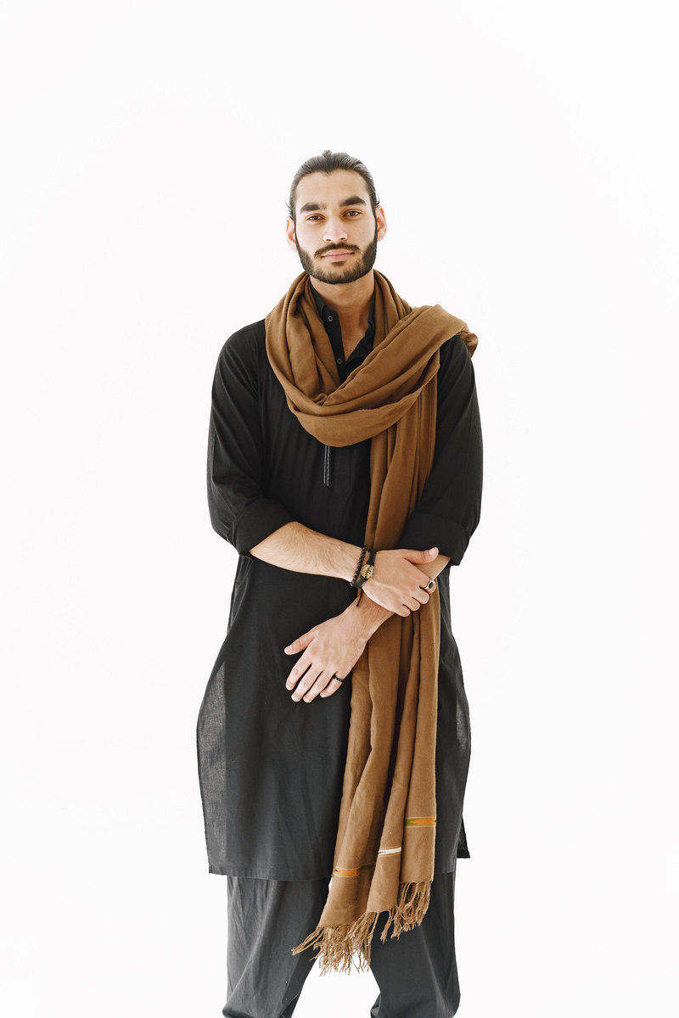
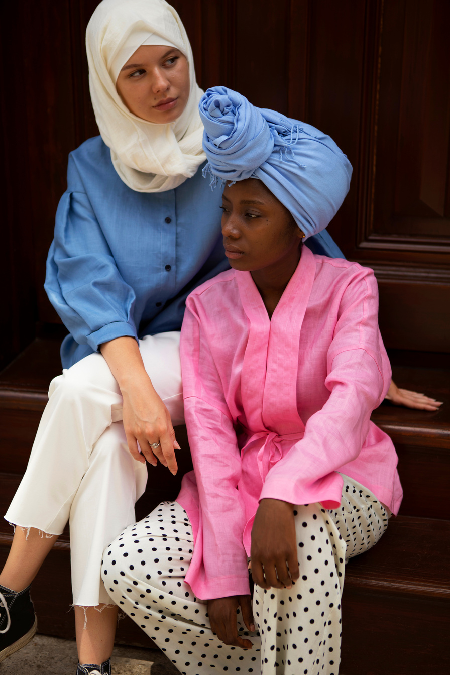

Men’s Fashion
Women’s Fashion
Coutures for ALL
You will get to see the most amazing fashion sense you have if you unleash it with our special men’s collection
You will get to see the most amazing fashion sense you have if you unleash it with our special women’s collection
You will get to see the most amazing fashion sense you have if you unleash it with our special collection for all

Slide 3
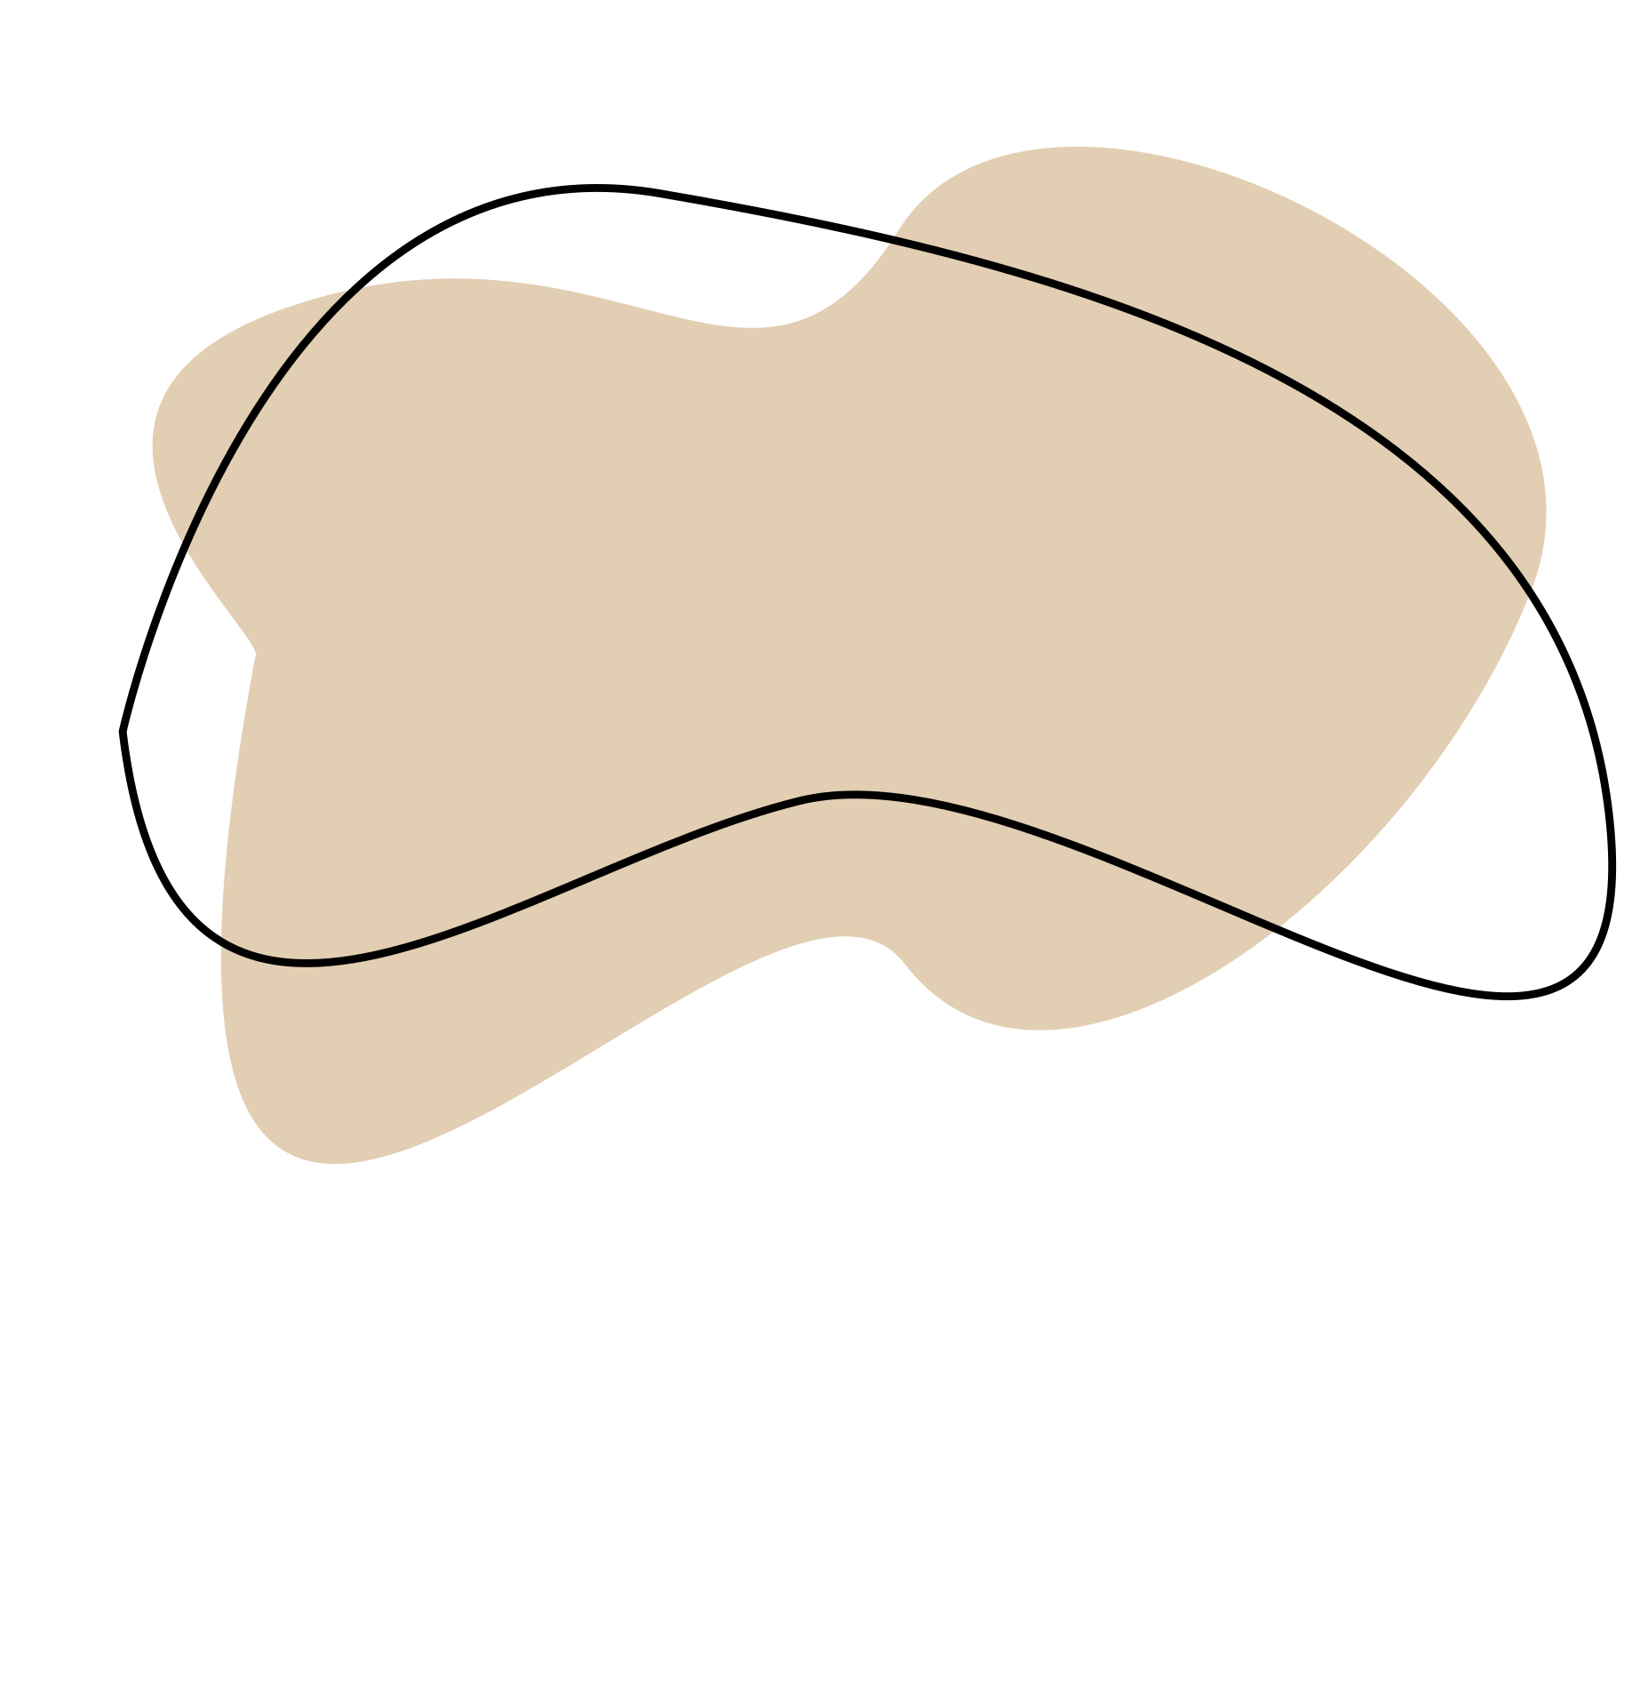
DRESS UP
No 8, Unity Road, Kofar Mata, Kano
elsamad@business.com
0909 888 8840

